Slide 1
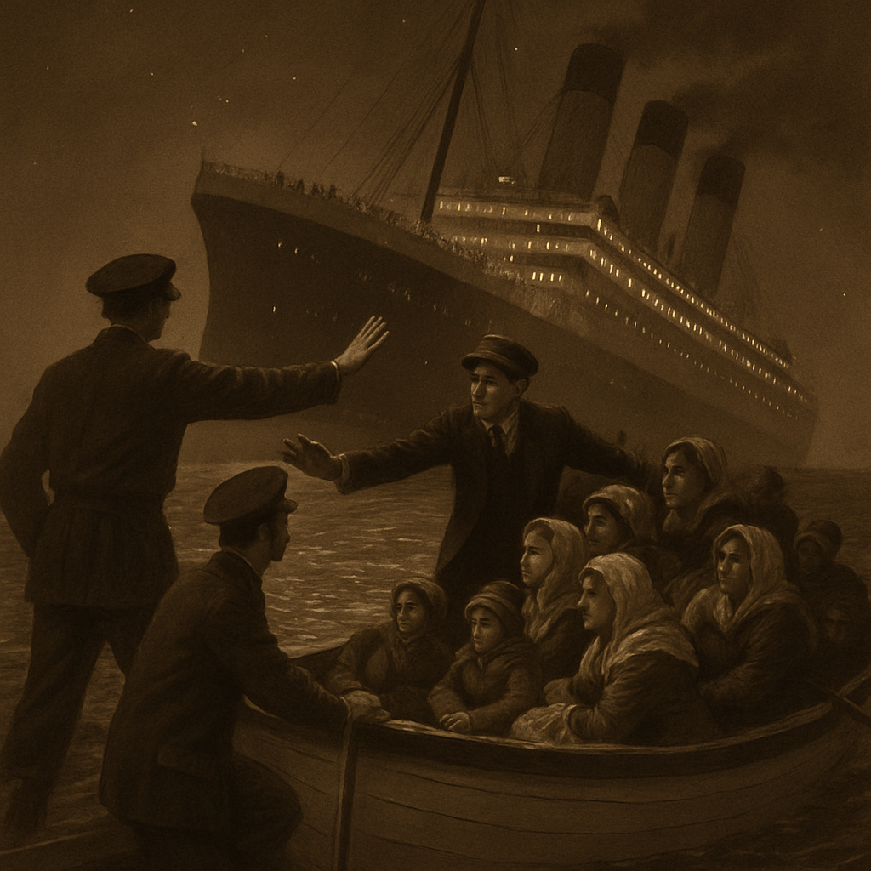
Titanic Incident Analysis
Here is where the story begins

Slide 2
TABLE OF CONTENTS
01
02
03
04
Introduction
About Dataset
Analysis
Conclusion

Slide 3

01
INTRODUCTION

Slide 4
Decoding the Disaster
What is Titanic?
Project Goal
The Titanic was a British Ship that sank on its maiden voyage from Southampton to New York City on April 15, 1912, after hitting an iceberg in the North Atlantic. Over 999+ passengers and crew died, making it one of the deadliest marine disasters. The tragedy exposed major flaws in ship safety regulations, lifeboat protocols, and class-based survival.
We all know the famous phrase: "Women and children first!" We remember it from the movie Titanic, like when the officer shouted, "Step back, sir! Women and children only!" or when Cal, Rose's wealthy fiancé, lied by yelling, "I have a child!" just to secure a spot on a lifeboat. But did this actually happen? Or did the film exaggerate for dramatic effect? I wanted to investigate what was really behind the story of survival on the Titanic. Was it truly a matter of humanity, as they say? Or were there other, more decisive criteria that determined who lived and who died?

Slide 5
Myth vs Reality
We’ve all heard the dramatic cry: "Women and children first!"—immortalized in the Titanic film as officers shouted orders and desperate passengers scrambled for lifeboats. One unforgettable scene shows Cal, Rose’s wealthy fiancé, faking fatherhood to steal a spot on a lifeboat. But how much of this was real?
In truth, the idea of a chivalrous evacuation is more myth than reality. While some officers enforced the "women and children first" protocol, it wasn’t applied consistently. Survival wasn’t just about gender or age—it was about class, location on the ship, and luck. First-class passengers had far better access to lifeboats, while many third-class families were trapped below decks with little guidance or time to escape.
The romanticized version makes for powerful cinema. But the data tells a colder, more chaotic story—one driven not only by humanity, but also by inequality and systemic failure.

Slide 6
02
About Dataset

Slide 7
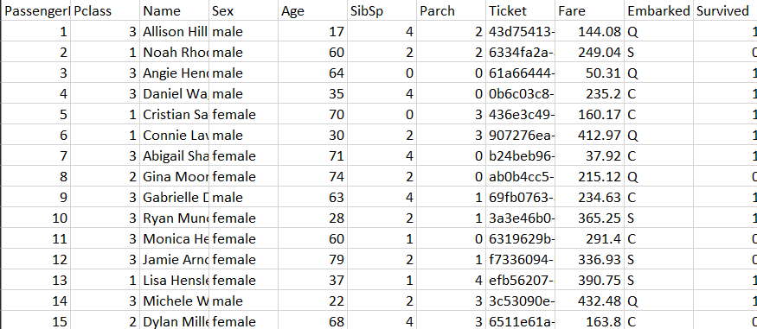
This dataset contains information on 1,000 passengers who were aboard the RMS Titanic when it sank on April 15, 1912
PassengerId: A unique ID for each passenger.
Pclass: The passenger's socio-economic class (1 = 1st, 2 = 2nd, 3 = 3rd).
Name: The full name of the passenger.
Sex: The gender of the passenger.
Age: The age of the passenger in years.
SibSp: The number of siblings and spouses the passenger had aboard.
Parch: The number of parents and children the passenger had aboard.
Ticket: The passenger's unique ticket number.
Fare: The price paid for the ticket.
Embarked: The port where the passenger boarded (C = Cherbourg, Q = Queenstown, S = Southampton).
Survived: The target variable indicating survival (0 = No, 1 = Yes).

Slide 8

03
Analysis

Slide 9
1000
394
164
Passengers on Board
Females
Children

Slide 10
229
Female
Children
80
Survivors

Slide 11
Survival Rate in Each Sex
Male
Female

Slide 12
04
Conclusion

Slide 13
The Reality of the Titanic
While the famous phrase “Women and children first!” has been immortalized in movies like Titanic, our data tells a more complex story. Out of 1000 passengers:
Only 164 were children, and their survival numbers 80 were modest compared to adults.
Females made up 394, yet their survival rate was lower than expected.
In total, only 47% of survivors were female, while 53% were male—challenging the belief that women had priority.
The survival pattern appears to have been influenced more by factors like boarding port and class rather than a clear moral code principle.
Our analysis suggests that it was more of a myth than a consistent reality.

Slide 14
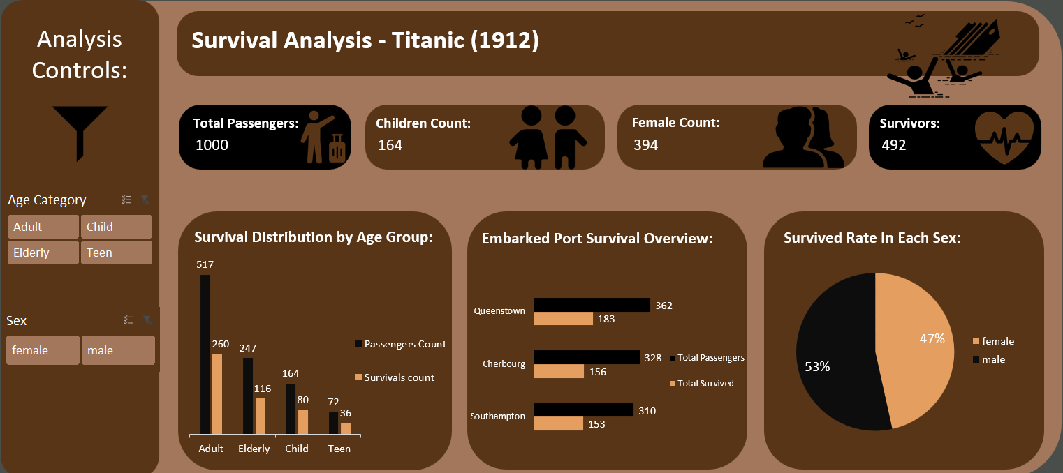
Dashboard Overview

